Slide 1

Chapter 3
Descriptive Statistics: Numerical Measures

Slide 2
Contents
Measures of Location
Measures of Variability
Measures of Shape
Box Plot
Covariance & Correlation

Slide 3
Numerical Measures
If the measures are computed for data from a sample, they are called sample statistics.
If the measures are computed for data from a population, they are called population parameters.
A sample statistic is referred to as the point estimator of the corresponding population parameter.

Slide 4
Measures of Location
Mean
Median
Mode
Weighted Mean
Geometric Mean
Percentiles
Quartiles

Slide 5
Mean
Perhaps the most important measure of location is the mean.
The mean provides a measure of central location.
The mean of a data set is the average of all the data values.
The sample mean $\overline{x}$ is the point estimator of the population mean µ.

Slide 6

Sample Mean $\overline{x}$
$$\overline{x}=\frac{\sum{x_{i}}}{n}$$
where: Σx_{i} = sum of the values of n observations
n = number of observations in the sample

Slide 7

Population Mean μ
$$μ=\frac{\sum{x_{i}}}{N}$$
where: Σx_{i} = sum of the values of the N observations
N= number of observations in the population

Slide 8
Sample Mean $\overline{x}$
Example: Apartment Rents
Seventy efficiency apartments were randomly sampled in a college town. The monthly rents for these apartments are listed below.
545
715
530
690
535
700
560
700
540
715
540
540
540
625
525
545
675
545
550
550
565
550
625
550
550
560
535
560
565
580
550
570
590
572
575
575
600
580
670
565
700
585
680
570
590
600
649
600
600
580
670
615
550
545
625
635
575
650
580
610
610
675
590
535
700
535
545
535
530
540

Slide 9
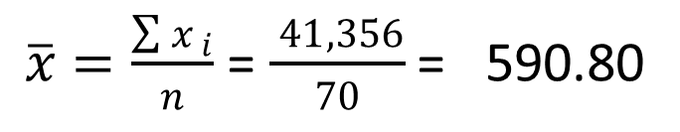
Sample Mean $\overline{x}$
Example: Apartment Rents
$\overline{x}=\frac{\sum{x_{ i}}}{n}$ = $\frac{ 41,356}{70}$ = 590.80

Slide 10
Mean – Grouped data
The following table gives the marks of 58 students in Statistics. Calculate the average marks of this group.
Marks | No. of Students
0-10 | 4
10-20 | 8
20-30 | 11
30-40 | 15
40-50 | 12
50-60 | 6
60-70 | 2

Slide 11
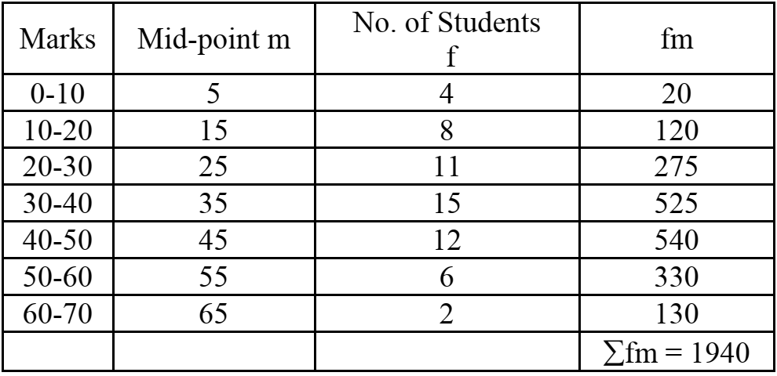
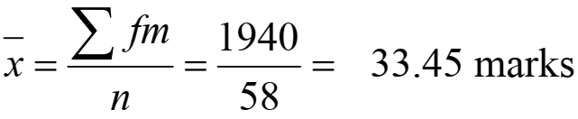
Mean – Grouped data
SOLUTION

Slide 12
Median
The median of a data set is the value in the middle when the data items are arranged in ascending order.
Whenever a data set has extreme values, the median is the preferred measure of central location.
The median is the measure of location most often reported for annual income and property value data.
A few extremely large incomes or property values can inflate the mean.

Slide 13
Median
For an odd number of observations:
26
18
27
12
14
27
19
7 observations
12
14
18
19
26
27
27
in ascending order
The median is the middle value. Median = 19

Slide 14
Median
For an even number of observations:
26
18
27
12
14
27
30
19
8 observations
12
14
18
19
26
27
27
30
in ascending order
The median is the average of the two middle values.
Median = (19 + 26)/2 = 22.5

Slide 15
Median
Example: Apartment Rents
Averaging the 35th and 36th data values:
Median = (575 + 575)/2 = 575
525
530
530
535
535
535
535
535
540
540
540
540
540
545
545
545
545
545
550
550
550
550
550
550
550
560
560
560
565
565
565
570
570
572
575
575
575
580
580
580
580
585
590
590
590
600
600
600
600
610
610
615
625
625
625
635
649
650
670
670
675
675
680
690
700
700
700
700
715
715
Note: Data is in ascending order.

Slide 16
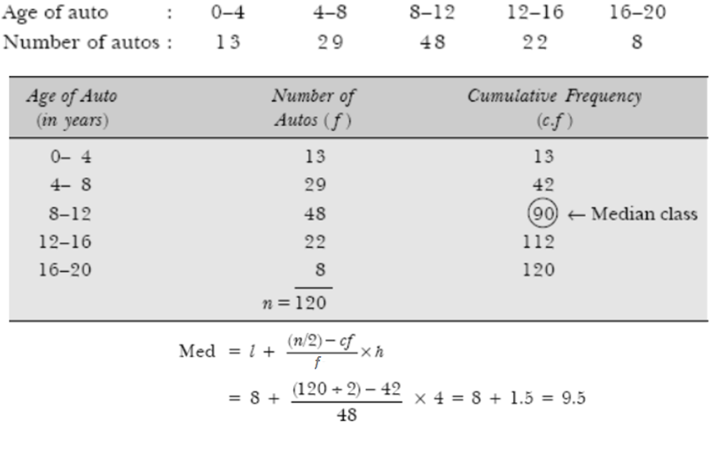
Median – Grouped Data

Slide 17
Trimmed Mean
Another measure, sometimes used when extreme values are present, is the trimmed mean.
It is obtained by deleting a percentage of the smallest and largest values from a data set and then computing the mean of the remaining values.
For example, the 5% trimmed mean is obtained by removing the smallest 5% and the largest 5% of the data values and then computing the mean of the remaining values.

Slide 18
Mode
The mode of a data set is the value that occurs with greatest frequency.
The greatest frequency can occur at two or more different values.
If the data have exactly two modes, the data are bimodal.
If the data have more than two modes, the data are multimodal.

Slide 19
Mode
Example: Apartment Rents
550 occurred most frequently (7 times)
Mode = 550
525
530
530
535
535
535
535
535
540
540
540
540
540
545
545
545
545
545
550
550
550
550
550
550
550
560
560
560
565
565
565
570
570
572
575
575
575
580
580
580
580
585
590
590
590
600
600
600
600
610
610
615
625
625
625
635
649
650
670
670
675
675
680
690
700
700
700
700
715
715
Note: Data is in ascending order.

Slide 20
Weighted Mean
In some instances the mean is computed by giving each observation a weight that reflects its relative importance.
The choice of weights depends on the application.
The weights might be the number of credit hours earned for each grade, as in GPA.
In other weighted mean computations, quantities such as pounds, dollars, or volume are frequently used.

Slide 21
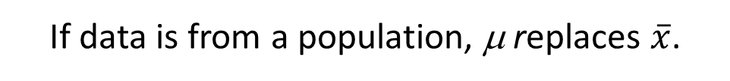
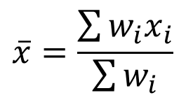
Weighted Mean
$$\overline{x}=\frac{\sum{w_{i}x_{i}}}{\sum{w_{i}}}$$
where: x_{i} = value of observation i
w_{i} = weight for observation i
Numerator: sum of the weighted data values
Denominator: sum of the weights
If data is from a population, μ replaces $\overline{x}$.

Slide 22
Weighted Mean
Example: Construction Wages
Ron Butler, a home builder, is looking over the expenses he incurred for a house he just built. For the purpose of pricing future projects, he would like to know the average wage ($/hour) he paid the workers he employed. Listed below are the categories of workers he employed, along with their respective wage and total hours worked.

Slide 23
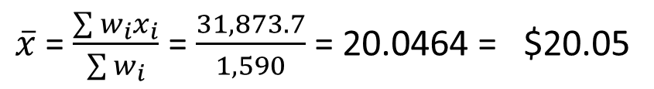
Weighted Mean
Example: Construction Wages
$\overline{x}$ = $\frac{\sum{w_{i}x_{i}}}{\sum{w_{i}}}$ = $\frac{31,873.7}{1,590}$ = 20.0464 = $20.05
FYI, equally-weighted (simple) mean = $21.21

Slide 24
Geometric Mean
The geometric mean is calculated by finding the nth root of the product of n values.
It is often used in analyzing growth rates in financial data (where using the arithmetic mean will provide misleading results).
It should be applied anytime you want to determine the mean rate of change over several successive periods (be it years, quarters, weeks, . . .).
Other common applications include: changes in populations of species, crop yields, pollution levels, and birth and death rates.

Slide 25

Geometric Mean
$${\overline{x}}_{g}= \sqrt[n]{\left(x_{1}\right)\left(x_{2}\right)…(x_{n})}$$
= [(x₁)(x₂)…(x_{n})]^{1/n}

Slide 26

Geometric Mean
Example: Rate of Return
$${\overline{x}}_{g}= \sqrt[5]{\left(.94\right).92)(.96)(1.02)(1.054)}$$
= [.89254]^{1/5} = .97752
Average growth rate per period is (.97752 - 1) (100) = -2.248%

Slide 27
Percentiles
A percentile provides information about how the data are spread over the interval from the smallest value to the largest value.
Admission test scores for colleges and universities are frequently reported in terms of percentiles.
The pth percentile of a data set is a value such that at least p percent of the items take on this value or less and at least (100 - p) percent of the items take on this value or more.

Slide 28
Percentiles
Arrange the data in ascending order.
Compute L_{p}, the location of the pth percentile.
L_{p} = (p/100)(n + 1)

Slide 29
80th Percentile
Example: Apartment Rents
L_{p} = (p/100)(n + 1) = (80/100)(70 + 1) = 56.8
(the 56th value plus .8 times the
difference between the 57th and 56th values)
80th Percentile = 635 + .8(649 – 635) = 646.2
525
530
530
535
535
535
535
535
540
540
540
540
540
545
545
545
545
545
550
550
550
550
550
550
550
560
560
560
565
565
565
570
570
572
575
575
575
580
580
580
580
585
590
590
590
600
600
600
600
610
610
615
625
625
625
635
649
650
670
670
675
675
680
690
700
700
700
700
715
715

Slide 30
80th Percentile
Example: Apartment Rents
“At least 80% of the
items take on a
value of 646.2 or less.”
“At least 20% of the
items take on a
value of 646.2 or more.”
56/70 = .8 or 80%
14/70 = .2 or 20%
525
530
530
535
535
535
535
535
540
540
540
540
540
545
545
545
545
545
550
550
550
550
550
550
550
560
560
560
565
565
565
570
570
572
575
575
575
580
580
580
580
585
590
590
590
600
600
600
600
610
610
615
625
625
625
635
649
650
670
670
675
675
680
690
700
700
700
700
715
715

Slide 31
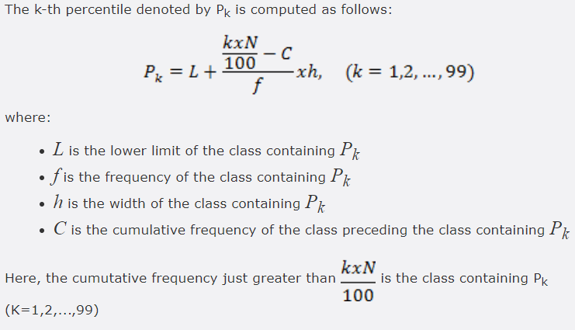
Percentiles – Grouped data

Slide 32
Quartiles
Quartiles are specific percentiles.
First Quartile, Q1 = 25th Percentile
Second Quartile, Q2 = 50th Percentile = Median
Third Quartile, Q3 = 75th Percentile

Slide 33
Third Quartile (75th Percentile)
Example: Apartment Rents
L_{p} = (p/100)(n + 1) = (75/100)(70 + 1) = 53.25
(the 53rd value plus .25 times the
difference between the 54th and 53rd values)
Third quartile = 625 + .25(625 – 625) = 625
525
530
530
535
535
535
535
535
540
540
540
540
540
545
545
545
545
545
550
550
550
550
550
550
550
560
560
560
565
565
565
570
570
572
575
575
575
580
580
580
580
585
590
590
590
600
600
600
600
610
610
615
625
625
625
635
649
650
670
670
675
675
680
690
700
700
700
700
715
715

Slide 34
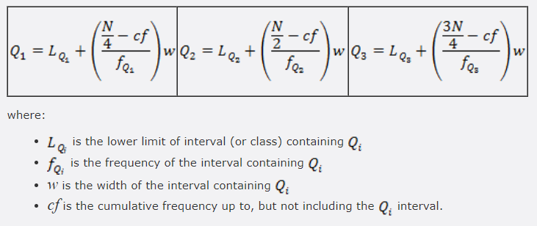
Quartiles – Grouped data

Slide 35
Measures of Variability
It is often desirable to consider measures of variability (dispersion), as well as measures of location.
For example, in choosing supplier A or supplier B we might consider not only the average delivery time for each, but also the variability in delivery time for each.

Slide 36
Measures of Variability
Range
Interquartile Range
Variance
Standard Deviation
Coefficient of Variation

Slide 37
Range
The range of a data set is the difference between the largest and smallest data value.
Range = Largest value – Smallest value
It is the simplest measure of variability.
It is very sensitive to the smallest and largest data values.
32

Slide 38
Range
Example: Apartment Rents
Range = largest value - smallest value
Range = 715 - 525 = 190
525
530
530
535
535
535
535
535
540
540
540
540
540
545
545
545
545
545
550
550
550
550
550
550
550
560
560
560
565
565
565
570
570
572
575
575
575
580
580
580
580
585
590
590
590
600
600
600
600
610
610
615
625
625
625
635
649
650
670
670
675
675
680
690
700
700
700
700
715
715

Slide 39
Interquartile Range
The interquartile range of a data set is the difference between the third quartile and the first quartile.
It is the range for the middle 50% of the data.
It overcomes the sensitivity to extreme data values.

Slide 40
Interquartile Range (IQR)
Example: Apartment Rents
3rd Quartile (Q3) = 625
1st Quartile (Q1) = 545
IQR = Q3 - Q1 = 625 - 545 = 80
525
530
530
535
535
535
535
535
540
540
540
540
540
545
545
545
545
545
550
550
550
550
550
550
550
560
560
560
565
565
565
570
570
572
575
575
575
580
580
580
580
585
590
590
590
600
600
600
600
610
610
615
625
625
625
635
649
650
670
670
675
675
680
690
700
700
700
700
715
715

Slide 41
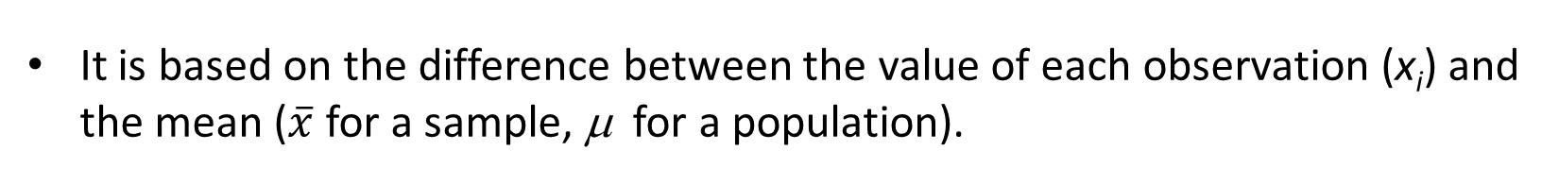
Variance
The variance is a measure of variability that utilizes all the data.
It is based on the difference between the value of each observation (x_{i}) and the mean ($\overline{x}$ for a sample, μ for a population).
The variance is useful in comparing the variability of two or more variables.

Slide 42
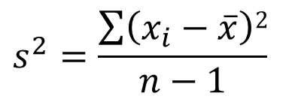
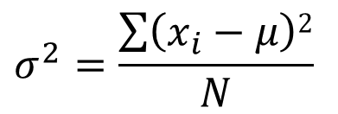
Variance
The variance is the average of the squared deviations between each data value and the mean.
The variance is computed as follows:
$$s^{2}=\frac{\sum{\left(x_{i}−\overline{x}\right)2}}{n−1}$$
$$σ^{2}=\frac{\sum{\left(x_{i}−μ\right)2}}{N}$$
for a
sample
for a
population

Slide 43


Variance – Grouped Data
The variance is computed as follows:
for a
sample
for a
population

Slide 44
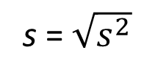
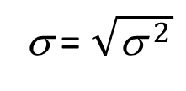
Standard Deviation
The standard deviation of a data set is the positive square root of the variance.
It is measured in the same units as the data, making it more easily interpreted than the variance.
The standard deviation is computed as follows:
s = $\sqrt{s^{2}}$
σ = $\sqrt{{\text{s} }^{2}}$
for a
sample
for a
population

Slide 45
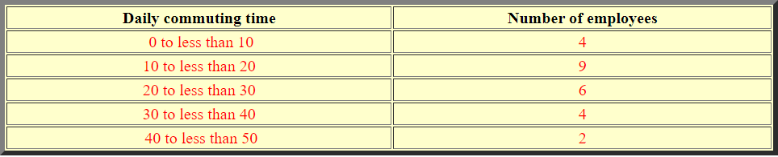
Example – Variance & Standard Deviation
The following gives the frequency distribution of the daily commuting time (in minutes) from home to work for all 25 employees of a company.

Slide 46
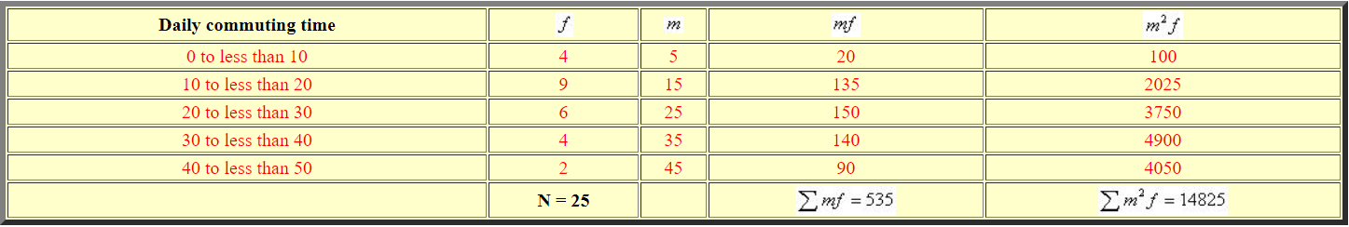
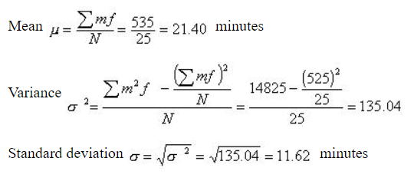
Solution

Slide 47
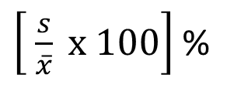
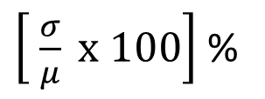
Coefficient of Variation
The coefficient of variation indicates how large the standard deviation is in relation to the mean.
The coefficient of variation is computed as follows:
$\left[ \frac{s}{\overline{x}} x 100\right]$ %
$\left[ \frac{σ}{μ} x 100\right]$ %
for a
sample
for a
population

Slide 48
Measures of Shape
Skewness
Absence of symmetry
Extreme values in one side of a distribution
Kurtosis
Peakedness of a distribution

Slide 49
Skewness
Negatively
Skewed – Left
Tail
Symmetric
(Not Skewed)
Positively
Skewed – Right
Tail

Slide 50
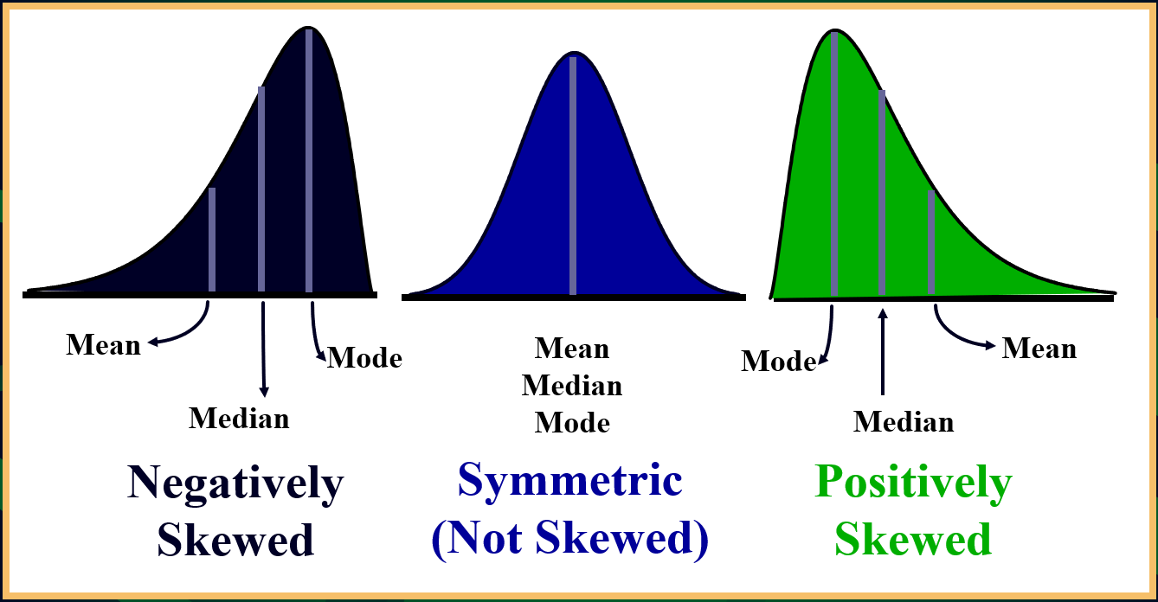
Skewness

Slide 51
Karl Pearson’s Coefficient of Skewness
Summary measure for skewness
If S < 0, the distribution is negatively skewed (skewed to the left).
If S = 0, the distribution is symmetric (not skewed).
If S > 0, the distribution is positively skewed (skewed to the right).
Mode = 3 Median – 2 Mode

Slide 52
Coefficient of Skewness

Slide 53
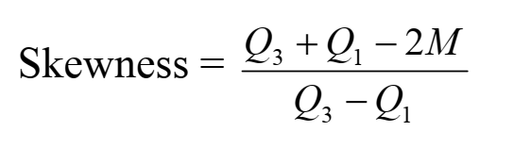
Bowley’s Measure of Skewness
Summary measure for skewness
where Q3 and Q1 are upper and lower quartiles and M is the median
value of this skewness varies between ±1

Slide 54
Skewness – Question for Practice
From the following data, calculate the measure of skewness using the mean, median and standard deviation:
X | 10-20 | 20-30 | 30-40 | 40-50 | 50-60 | 60-70 | 70-80
f | 18 | 30 | 40 | 55 | 38 | 20 | 16

Slide 55
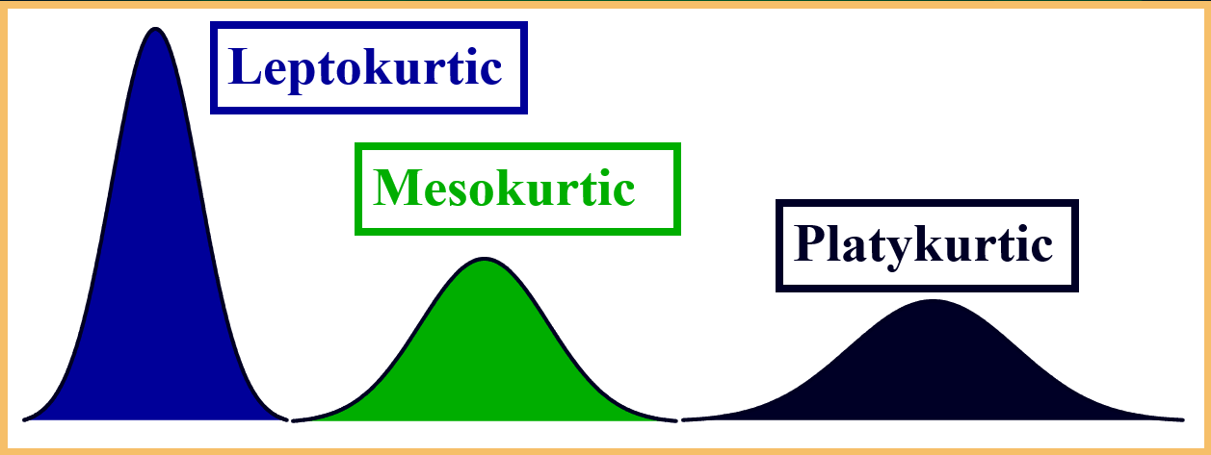
Kurtosis
Karl Pearson introduced the term Kurtosis (the amount of hump) for the degree of peakedness or flatness of a unimodal frequency curve / distribution.
Leptokurtic: high and thin
Mesokurtic: normal in shape
Platykurtic: flat and spread out

Slide 56
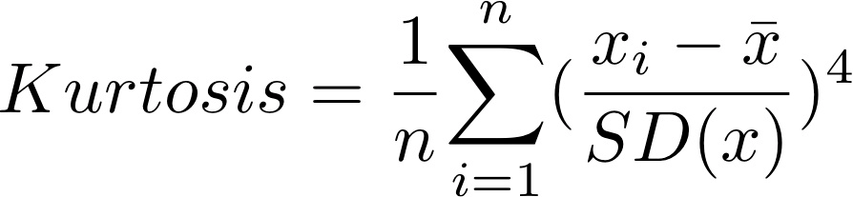
Kurtosis Formula
For a normal distribution / mesokurtic, kurtosis is equal to 3.
When is greater than 3, the curve is more sharply peaked and has narrower tails than the normal curve and is said to be leptokurtic.
When it is less than 3, the curve has a flatter top and relatively wider tails than the normal curve and is said to be platykurtic.

Slide 57
Kurtosis
Another measure of Kurtosis, known as Percentile coefficient of kurtosis is:
where, Q.D is semi-interquartile range=Q.D=(Q3-Q1)/2
P90=90th percentile
P10=10th percentile

Slide 58
Five-Number Summaries and Box Plots
Summary statistics and easy-to-draw graphs can be used to quickly summarize large quantities of data.
Two tools that accomplish this are five-number summaries and box plots.

Slide 59
Five-Number Summary
1. Smallest Value
2. First Quartile
3. Median
4. Third Quartile
5. Largest Value

Slide 60
Five-Number Summary
Example: Apartment Rents
Lowest Value = 525
First Quartile = 545
Median = 575
Third Quartile = 625
Largest Value = 715
525
530
530
535
535
535
535
535
540
540
540
540
540
545
545
545
545
545
550
550
550
550
550
550
550
560
560
560
565
565
565
570
570
572
575
575
575
580
580
580
580
585
590
590
590
600
600
600
600
610
610
615
625
625
625
635
649
650
670
670
675
675
680
690
700
700
700
700
715
715

Slide 61
Box Plot
A box plot is a graphical display of data that is based on a five-number summary.
A key to the development of a box plot is the computation of the median and the quartiles Q₁ and Q₃.
Box plots provide another way to identify outliers.

Slide 62
Box Plot
Example: Apartment Rents
A box is drawn with its ends located at the first and third quartiles.
A vertical line is drawn in the box at the location of the median (second quartile).
500
525
550
575
600
625
650
675
700
725
Q1 = 545
Q3 = 625
Q2 = 575

Slide 63
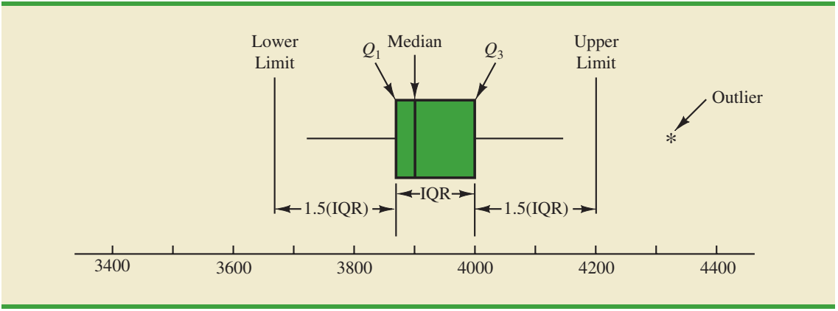
Box Plot
Limits are located (not drawn) using the interquartile range (IQR).
Data outside these limits are considered outliers.
The location of each outlier is shown with the symbol * .

Slide 64
Box Plot
Example: Apartment Rents
The lower limit is located 1.5(IQR) below Q1.
Lower Limit: Q1 - 1.5(IQR) = 545 - 1.5(80) = 425
The upper limit is located 1.5(IQR) above Q3.
Upper Limit: Q3 + 1.5(IQR) = 625 + 1.5(80) = 745
There are no outliers (values less than 425 or greater than 745) in the apartment rent data.

Slide 65
Box Plot
Example: Apartment Rents
Whiskers (dashed lines) are drawn from the ends of the box to the smallest and largest data values inside the limits.
500
525
550
575
600
625
650
675
700
725
Smallest value
inside limits = 525
Largest value
inside limits = 715

Slide 66
Measures of Association Between Two Variables
Thus far we have examined numerical methods used to summarize the data for one variable at a time.
Often a manager or decision maker is interested in the relationship between two variables.
Two descriptive measures of the relationship between two variables are covariance and correlation coefficient.

Slide 67
Covariance
The covariance is a measure of the linear association between two variables.
Positive values indicate a positive relationship.
Negative values indicate a negative relationship.

Slide 68
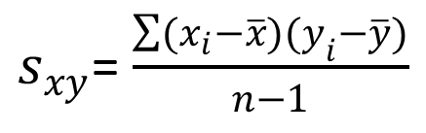
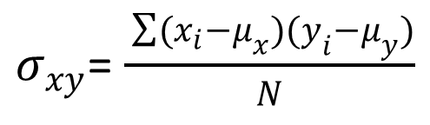
Covariance
The covariance is computed as follows:
$s_{xy}$= $\frac{\sum{(x_{i}}−\overline{x})(y_{i}−\overline{y})}{n−1}$
For samples:
$σ_{xy}$=$\frac{ \sum{(x_{i}}−μ_{x})(y_{i}−μ_{y})}{N}$
For populations:

Slide 69
Correlation Coefficient
Correlation is a measure of linear association and not necessarily causation.
Just because two variables are highly correlated, it does not mean that one variable is the cause of the other.

Slide 70
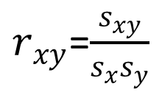
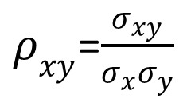
Correlation Coefficient
The correlation coefficient is computed as follows:
$r_{xy}$=$\frac{s_{xy}}{s_{x}s_{y}}$
For samples:
$ρ_{xy}$=$\frac{σ_{xy}}{σ_{x}σ_{y}}$
For populations:

Slide 71
Correlation Coefficient
The coefficient can take on values between -1 and +1.
Values near -1 indicate a strong negative linear relationship.
Values near +1 indicate a strong positive linear relationship.
The closer the correlation is to zero, the weaker the relationship.

Slide 72
Covariance and Correlation Coefficient
Example: Golfing Study
A golfer is interested in investigating the relationship, if any, between driving distance and 18-hole score.
Average Driving
Distance (yds.)
Average
18-Hole Score
277.6
259.5
269.1
267.0
255.6
272.9
69
71
70
70
71
69

Slide 73




Covariance and Correlation Coefficient
Example: Golfing Study
x
y
$(x_{i}$-$\overline{x})$
$(y_{i}$-$\overline{y})$
$(x_{i}$-$\overline{x})$
$(y_{i}$-$\overline{y})$
277.6
259.5
269.1
267.0
255.6
272.9
69
71
70
70
71
69
10.65
-7.45
2.15
0.05
-11.35
5.95
-1.0
1.0
0
0
1.0
-1.0
-10.65
-7.45
0
0
-11.35
-5.95
Average
267.0
70.0
Total
-35.40
Std. Dev.
8.2192
.8944

Slide 74
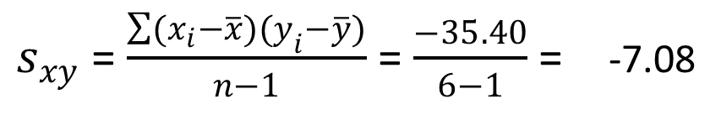
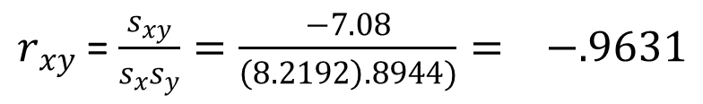
Covariance and Correlation Coefficient
Example: Golfing Study
Sample Covariance
$s_{xy}$ =$\frac{\sum{(x_{i}}−\overline{x})(y_{i}−\overline{y})}{n−1}$ = $\frac{−35.40}{6−1}$ = -7.08
Sample Correlation Coefficient
$r_{xy}$ = $\frac{s_{xy}}{s_{x}s_{y}}=\frac{−7.08}{\left(8.2192\right).8944)}= −.9631$

Slide 75
End of Chapter 3

